Slide 1
Fraudulent Claim Detection
Advanced ML Case Study - Assignment
By,
Anish Dhondi
Ankit Shrivastava

Slide 2
Problem Statement
Global Insure, a leading insurance company, processes thousands of claims annually. However, a significant percentage of these claims turn out to be fraudulent, resulting in considerable financial losses. The company’s current process for identifying fraudulent claims involves manual inspections, which is time-consuming and inefficient. Fraudulent claims are often detected too late in the process, after the company has already paid out significant amounts. Global Insure wants to improve its fraud detection process using data-driven insights to classify claims as fraudulent or legitimate early in the approval process. This would minimise financial losses and optimise the overall claims handling process.
Business Objective
Global Insure wants to build a model to classify insurance claims as either fraudulent or legitimate based on historical claim details and customer profiles. By using features like claim amounts, customer profiles and claim types, the company aims to predict which claims are likely to be fraudulent before they are approved.

Slide 3
Summary Of findings
🔍 What We Did
Analyzed historical claim data from Global Insure.
Performed data cleaning, EDA, and feature engineering.
Built and compared Logistic Regression and Random Forest models.
Tuned cutoffs and hyperparameters for optimal performance.

Slide 4
Summary Of findings
📈 What We Observed
Fraud cases are fewer but costlier. Claims with high severity and specific hobbies showed higher fraud likelihood.
Certain vehicle models and occupations are linked with fraud.
Key numeric features like total_claim_amount, injury_ratio, and property_claim were highly predictive.
Random Forest initially overfit; Logistic Regression offered stable generalization.

Slide 5
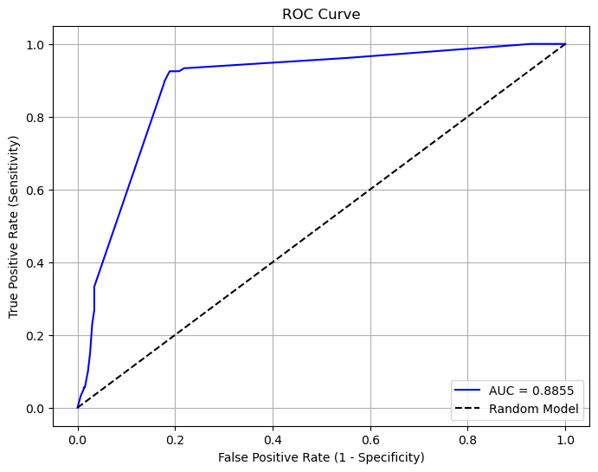
Model Evaluation – ROC Curve
Observation: The ROC Curve illustrates strong classification ability with high AUC. This suggests the model is capable of distinguishing between fraudulent and legitimate claims effectively.

Slide 6
Summary Of findings
🏁 Final Outcome
Selected Model: Logistic Regression with 0.4 cutoff.
Recall: 87.5% (captures more fraud).
F1 Score: 74.1% (balanced performance).
Deployment-Ready: Interpretable, scalable, and business-aligned.
Metric | Logistic Regression (cutoff=0.4) | Random Forest (tuned)
Accuracy | 86.80% | 83.20%
Precision | 64.30% | 66.30%
Recall | 87.50% | 73.60%
Specificity | 82.60% | 86.60%
F1 Score | 74.10% | 69.70%

Slide 7
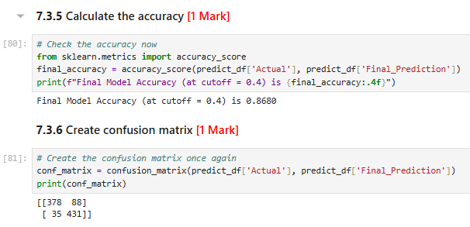
Confusion Matrix – Logistic Regression (Cutoff = 0.4)
Observation: The confusion matrix shows the model captures a high number of actual frauds (high recall of 86.8%), although with some false positives — a desirable tradeoff for fraud detection tasks.

Slide 8
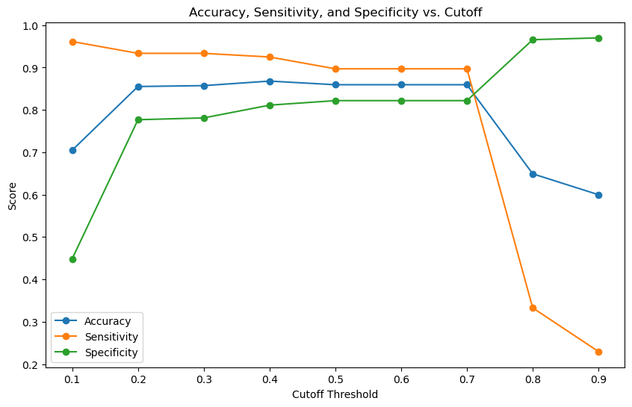
Model Metrics vs. Cutoff
Observation: This plot helps visualize the trade-off between sensitivity and specificity at various thresholds, supporting the decision to use a 0.4 cutoff for optimal fraud detection balance.

Slide 9
Recommendations
Deploy the Logistic Regression model with a cutoff of 0.4 to prioritize fraud detection with high recall (87.5%).
Use the model to flag high-risk claims for manual review, reducing financial loss.
Monitor false positives and adjust the cutoff as needed to balance precision and recall.
Integrate key predictors like incident_severity, insured_hobbies, and claim ratios into business rules.
Retrain the model periodically using new claim data to maintain accuracy and relevance.

Slide 10
Business implications
Reduced Fraudulent Payouts Leveraged early detection and automated flagging of suspicious claims to minimize financial losses from fraud.
Increased Operational Efficiency Focused manual reviews on high-risk claims, streamlining processes and reducing unnecessary workload.
Improved Customer Experience Fast-tracked low-risk claims for quicker approvals and payouts, enhancing trust and satisfaction.
Data-Driven Risk Management at Scale Used predictive analytics to assign risk scores, enabling informed and consistent decisions across large claim volumes.

Slide 11
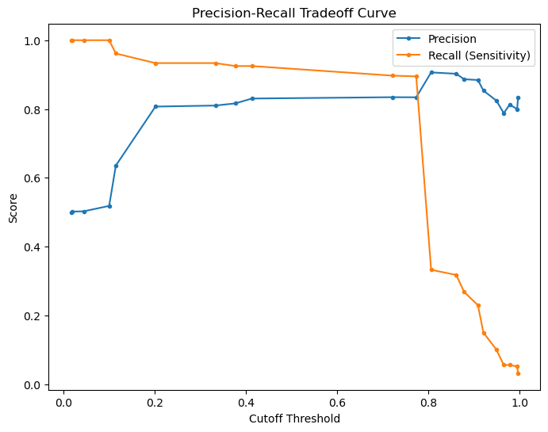
Precision vs. Recall Tradeoff
Observation: The precision-recall curve indicates strong recall performance even at lower precision, making it suitable for minimizing false negatives in fraud detection.

Slide 12
Answers to the Questions
How can we analyse historical claim data to detect patterns that indicate fraudulent claims? We used Logistic Regression and Random Forest to analyze labeled historical claim data. Key steps included: - Selecting important features that contribute most to fraud detection. - Applying resampling techniques to address class imbalance and ensure fair model training. - Measuring performance using recall, precision, and F1 score to assess fraud detection accuracy. By comparing both models' responses to past claims, we identified features which correlate with fraudulent activity. This helped refine fraud detection

Slide 13
Which features are most predictive of fraudulent behaviour? From model training and importance analysis of the Logistic Regression model, the most predictive features included: - insured_hobbies_chess - insured_hobbies_cross-fit - insured_hobbies_video-games - incident_severity_Minor Damage - incident_severity_Total Loss - incident_severity_Trivial Damage - Auto_model_92x

Slide 14
Can we predict the likelihood of fraud for an incoming claim, based on past data? Yes - - Model Training: Logistic Regression and Random Forest were trained on historical claim data. Both models assign a fraud probability to incoming claims.
- Importance of Recall: In fraud detection, recall is crucial to minimize missed fraud cases. We preferred higher recall even if it meant a few false positives.
- Model Comparison: Logistic Regression (cutoff = 0.4) gave 87.5% recall. Random Forest had 73.6% recall but slightly higher precision.
- Final Choice – Logistic Regression: LR balances precision and recall with F1 score of 74.1%. It's simpler, interpretable, and ideal for deployment.

Slide 15
What insights can be drawn from the model that can help in improving the fraud detection process? - Logistic Regression works better for fraud detection since it catches more fraudulent cases with higher recall. - Random Forest is more precise, but it tends to miss fraud cases, making it less useful in situations where missing fraud is risky. - Adjusting the cutoff from 0.5 to 0.4 for Logistic Regression improves fraud detection by striking a balance between recall and specificity. - The most important features identified can be used to improve screening and fraud detection systems.

Slide 16
Thank You

